Slide 1
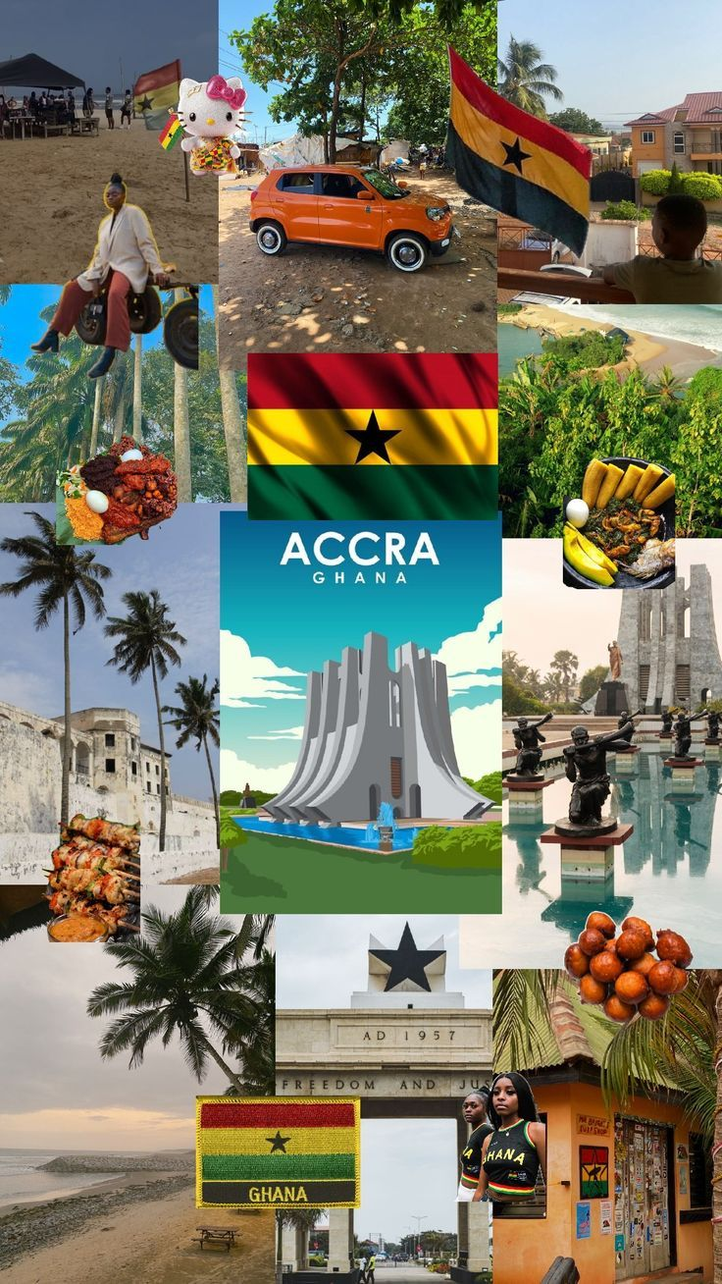
DATA-DRIVEN BUSINESS INSIGHTS FOR GHANA ADVENTURES
Team Members:
ANDY MAWUTORNAM KLUTSE, ANGELA SERWAA ADU & BERNARD AKUMANI

Slide 2
OVERVIEW AND OBJECTIVE
Overview
Ghana Adventures, a travel and tour company based in Tamale that offers domestic and international tour packages, corporate travel services, and adventure trips, faces inconsistent bookings, low customer retention, and underperforming tour packages. This analysis uses data insights to understand trends and guide strategic improvements.
Objectives
The analysis aims to;
1. Forecast bookings and revenue trends.
2. Increase off-season bookings through targeted marketing.
3. Optimize tour offerings based on performance.
4. Improve customer retention with personalized strategies.

Slide 3
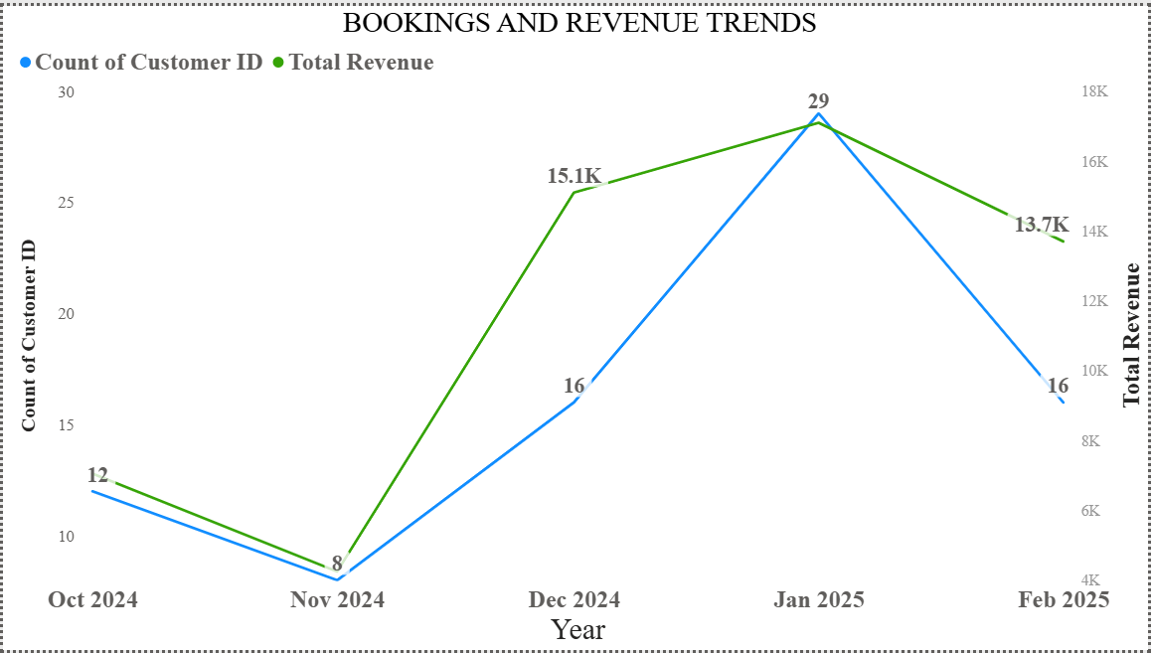
BOOKING AND REVENUE TRENDS OVER TIME
INSIGHTS
Seasonal fluctuations: Clear peak during holidays and no-holiday seasons, with significant dips in off-peak months affecting cash flow.
Revenue growth uneven: High sales concentrated in a few months, indicating reliance on limited travel seasons.

Slide 4
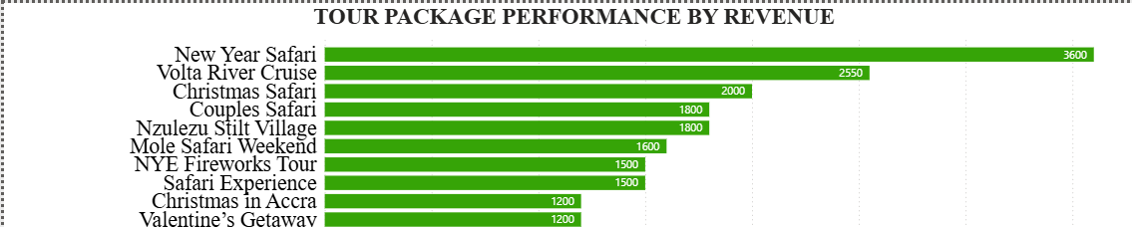
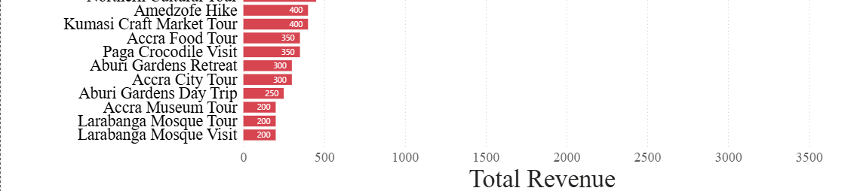
TOUR PACKAGE PERFORMANCE
INSIGHTS
Top-performing tours: Safari and eco-tour packages generate the highest revenue, showing strong demand for nature and adventure experiences.
Underperforming packages: Historical, such as Larabange mosque tours, attract fewer customers, suggesting a need for rebranding, pricing review, or bundled offers to boost appeal.

Slide 5
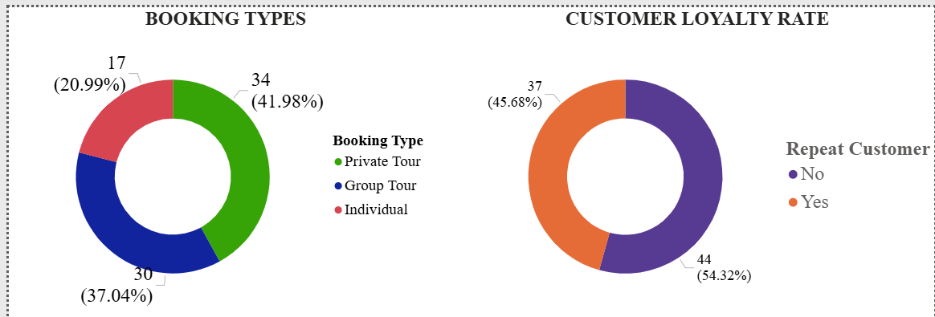
CUSTOMER BEHAVIOUR
INSIGHTS
Low repeat rate: Most customers book only once, indicating limited post-trip engagement and weak loyalty incentives.
Dominant booking types: Private bookings make up the largest share, followed by group travelers, with individual bookings being the least common, indicating a strong customer preference for exclusive and personalized tour experiences.

Slide 6
RECOMMENDATIONS & CONCLUSION
Recommendations
1. Cross-tour packages: Combine top-performing tours (e.g., safari or eco-tour) with underperforming ones (e.g., historical or international tours) to boost visibility and overall sales.
2. Launch a “Ghana Adventures Loyalty Program”: Introduce tiered rewards, referral incentives, and exclusive discounts to encourage repeat bookings and customer retention.
3. Data-driven marketing for off-season: Use booking trend analytics to run targeted digital campaigns and promotional discounts during low-demand months, focusing on local and regional travelers.
Conclusion
Data insights reveal clear opportunities for Ghana Adventures to achieve steady growth by optimizing tour offerings, personalizing customer experiences, and leveraging analytics to predict demand. Implementing these strategies will help stabilize bookings year-round, improve customer loyalty, and enhance overall profitability.

Slide 7
THANK YOU

